Slide 1




Management Science
Della Herli Rahman (16/394080/PA/17171)
Vincent Michael Sutanto (16/398531/PA/17492)

Slide 2

Transportation Management

Slide 3
Problem
Method
Implementation
Result

Slide 4
Problem
01
Orders
Origin
Destination
Qty
Weight
Minimum Cost
100

Slide 5
Problem
Method
Implementation
Result

Slide 6
Method
N Shortest Path Tree

Slide 7
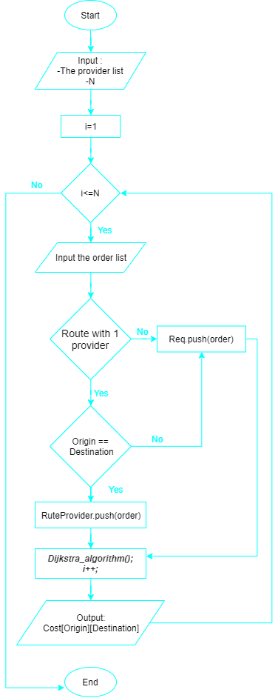
Method

Slide 8
Method

Slide 9
Method
Assign
Data[15][15] , 7 providers + 8 cities
Data[i][j]= cost city i using provider j
Input
1
Provider
Order
5
Output /order
3
cost * weight
4
2
Process /order
Preprocessing
Dijkstra's algorithm
Finding minimum cost by route
Update capacity and request
Filter Order
Sorting Orders

Slide 10
Problem
Method
Implementation
Result

Slide 11
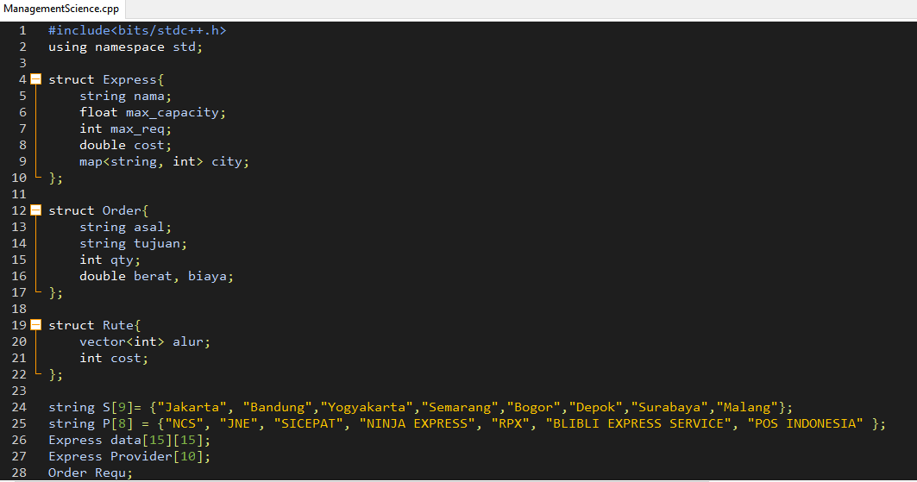
Implementation : C++

Slide 12
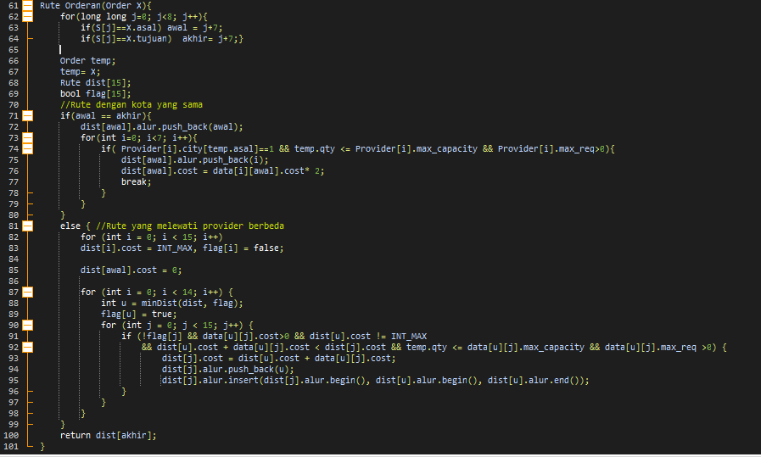
Implementation : https://github.com/dellahera/Transportation-Management/

Slide 13
Problem
Method
Implementation
Result

Slide 14
Result
01
Input
Total Cost:
Rp. 469.922.942, 00
100

Slide 15
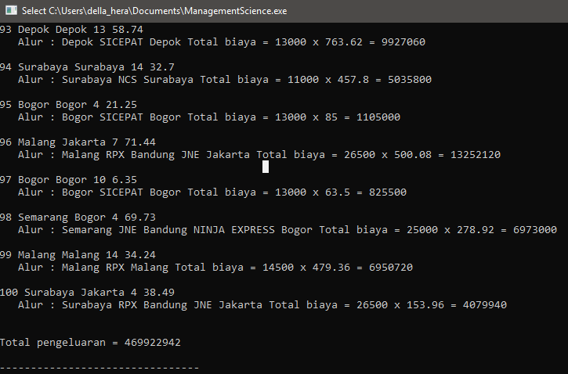
Result

Slide 16
Penjelasan Dijkstra's Algorithm
Dijkstra Algorithm digunakan untuk mengatasi permasalahan request yang harus dikirimkan dengan lebih dari 1 provider

Slide 17
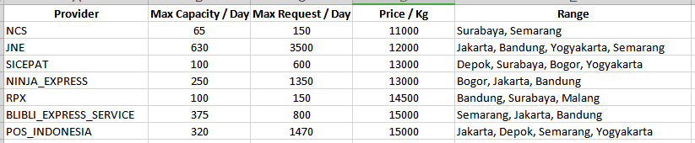
Penjelasan Dijkstra's Algorithm
Diubah menjadi Graf
- Vertex : nama provider dan kota yang dilayani
- Edge : hubungan provider dengan kota yang dilayaninya

Slide 18
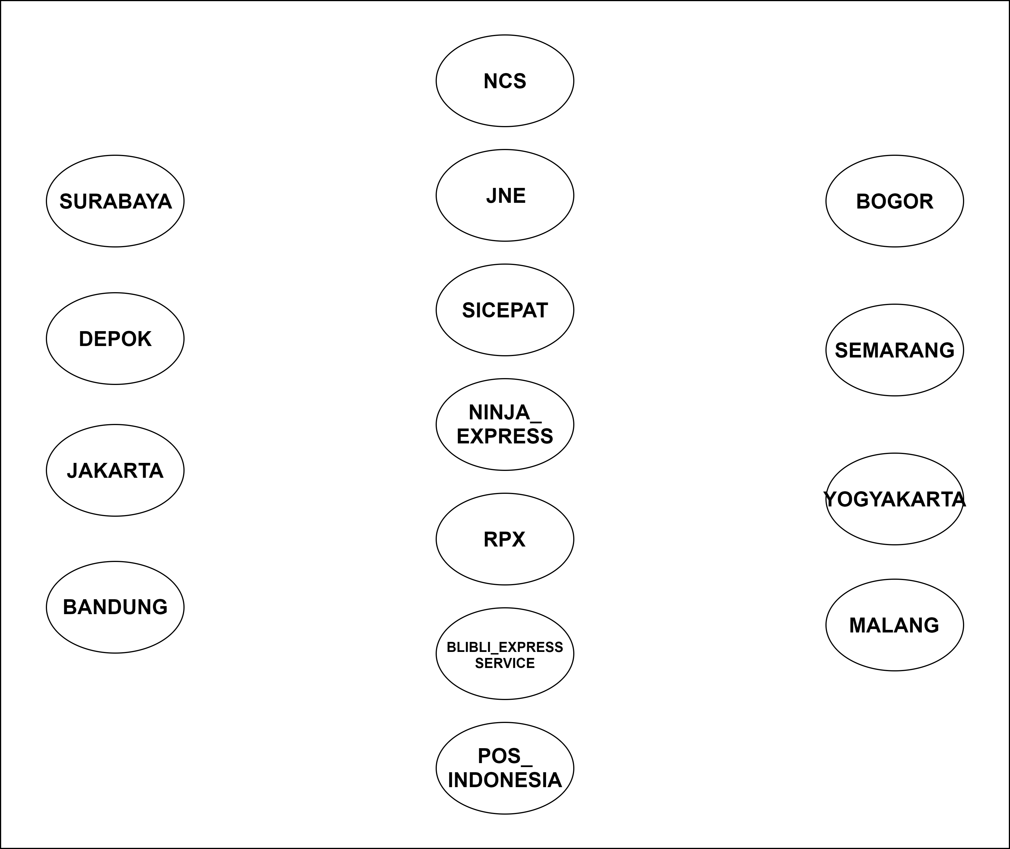
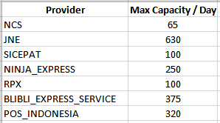
Penjelasan Dijkstra's Algorithm

Slide 19
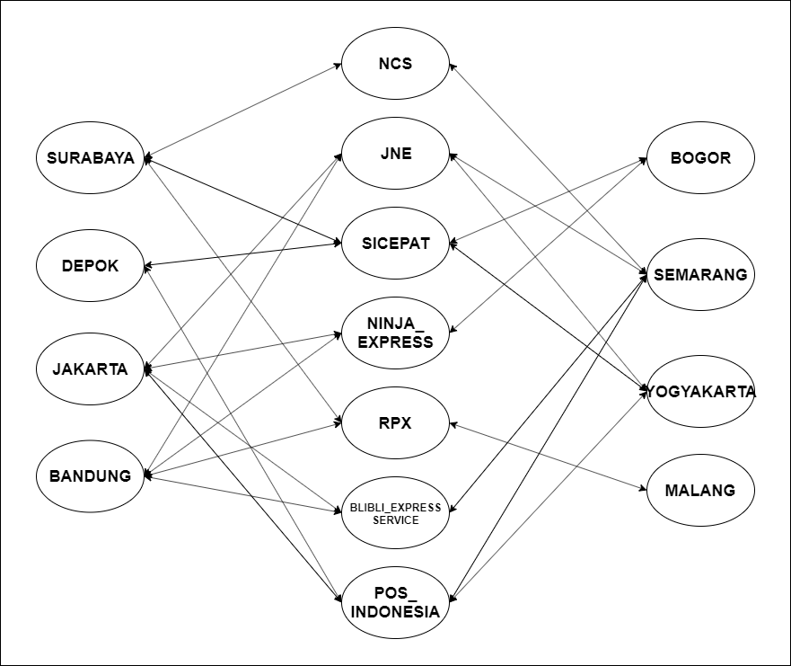
Penjelasan Dijkstra's Algorithm

Slide 20
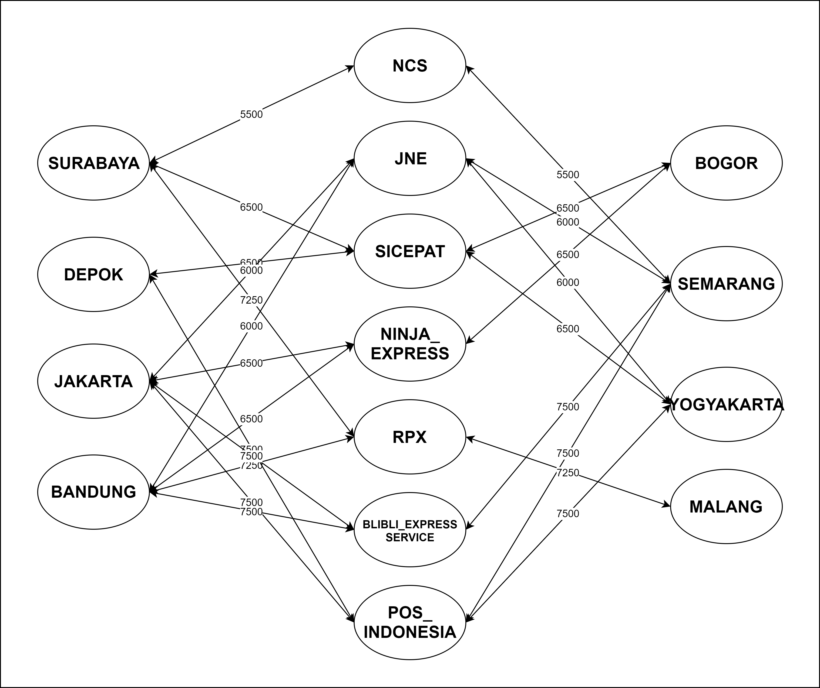
Penjelasan Dijkstra's Algorithm

Slide 21
Penjelasan Dijkstra's Algorithm
Case 1 :
menggunakan 1 provider

Slide 22
Penjelasan Dijkstra's Algorithm
Case 2 :
menggunakan lebih dari 1 provider

Slide 23
Thank you

